Slide 1


ASSET TRACKING SOLUTION WITH BLE-ENABLED TAGS
BY
SHUBHAM KUMAR SAURAV(18246)
AMIT KUMAR MISTRI(17937)
GUIDED BY
PROF. JOY KURI
PROF. HARESH DAGALE

Slide 2
Introduction
Motivation
High risk of theft and misplacement of luggage during travel
Objectives
Asset Securing System
An asset tracking product using Bluetooth Low Energy technology that keeps track of our asset’s presence in a predefined safe area and triggers an alarm once the object is out of the safe zone
Real time vehicle monitoring
Health Monitoring:
Monitoring parameters that affect the engine performance and fuel efficiency
Storing location for retracing the route taken by the vehicle in Google Maps
Monitoring driver’s behavior:
Parameters like vehicle speed helps to monitor driver’s behavior

Slide 3
Project Beneficiaries
Bus and vehicle Rent companies: This project is helpful for the bus companies to provide security to their passengers. Also, it will be helpful for the bus company to monitor their vehicle’s health
Value add on service for passengers & intercity delivery services: This project will be helpful for passengers who are traveling from one place to another. Also, those who wants to courier their packages can use this system to monitor their packages while in transit
Similar requirement for dynamic asset securing system

Slide 4
BLOCK DIAGRAMS AND ALGORITHMS
Asset Securing System
Vehicle Monitoring System

Slide 5






ASSET SECURING SYSTEM
GATEWAY
Lock Status
LOCK STATUS
ASSET STATUS
UNSAFE ASSET’s INFO
ASSET INFO

Slide 6
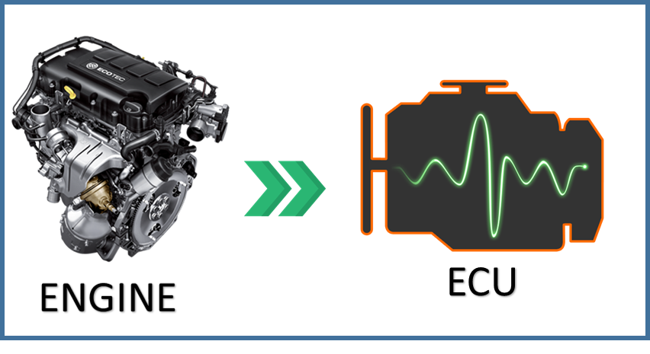

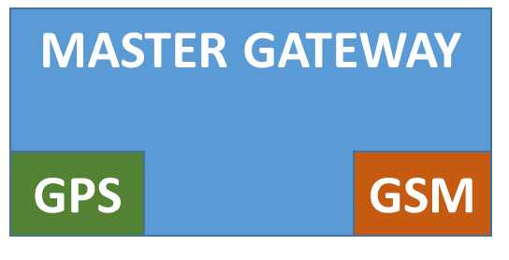



VEHICLE MONITORING SYSTEM
Location
&
Bus Data
Pending OTP
&
Loc SMS info
OBD Parameters
CAN
(Controller Area Network)
Location Coordinates
GNSS
(Global Navigation Satellite System)
OTP
Or
Last Location info

Slide 7
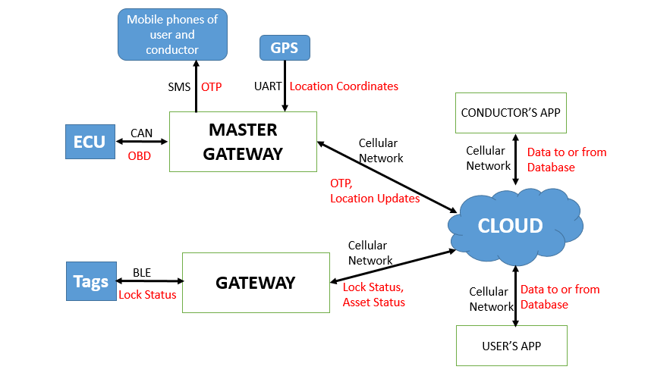
COMPLETE ARCHITECTURE

Slide 8
OTP Verification
Required during:
Password Reset
Mobile number verification
APP
SMS in User’s mobile number
OTP : XXXX
Mongo DB
{Random OTP Generation }
Cellular
Network
SMS
Cellular
Network
Master
Gateway
{Mob no}
{Mob no, OTP}
{OTP}
(https response)
{OTP}
{Mob no, OTP}
Verify Entered OTP from http response
New Document in database
{
Mob : “xxx”
OTP : “xxx”
}

Slide 9
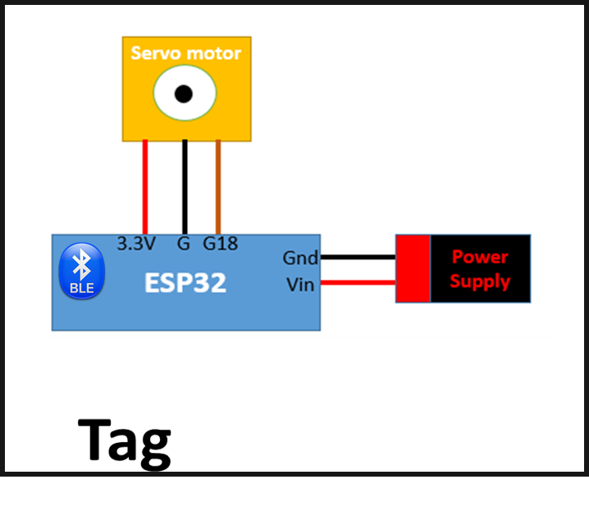
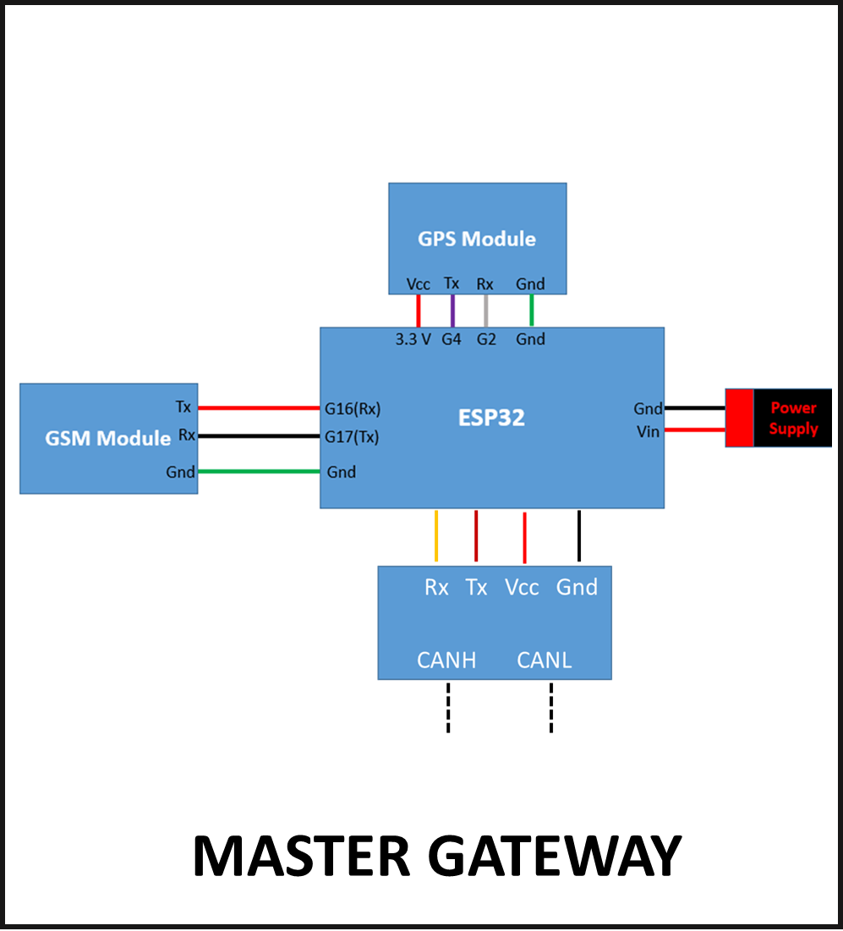
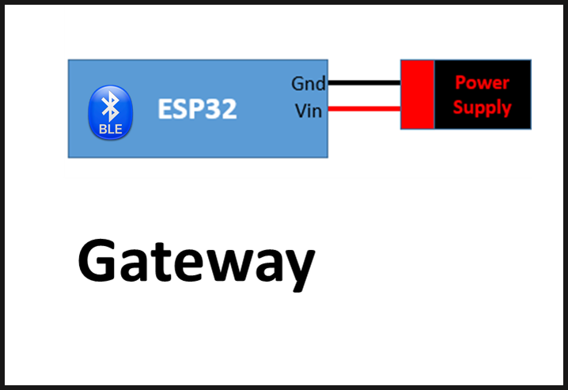

Slide 10
OBD 2.0 (On Board Diagnostic)
OBD was first introduced by General Motors in 1980 on their Eldorado and Seville models
USA:
1996 : Mandatory for all cars
2010: Heavy-duty vehicles included
India:
2010 : Limited to light-duty vehicles
April 2020 : Must for all vehicles
System provided in vehicles for self-diagnostic and reporting capabilities
To identify and fix the problems at early stage
The Engine control unit (ECU) depends on various sensor readings for certain calculations like correct air-fuel mixture etc.
Faulty sensors may lead to problems like :
Lesser Fuel Efficiency
Drop in acceleration
Increased hydrocarbon emission

Slide 11
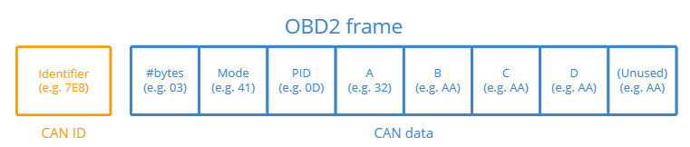
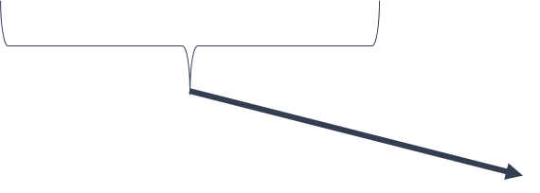
Information for calculating parameter value
Ex:
IAT = A-40
MAF =256A + B
11 bit
Number of bytes of remaining data
Request
(7DF)
Or
Response
(7E8)
10 OBD2 Diagnostic Services
Ex:
’01’ -> current data
‘02’ -> freeze frame data
Parameter ID:
Ex:
‘0D’ <-> Vehicle Speed
‘0F’ <-> IAT

Slide 12


Important OBD Parameters
IAT
MAF
MAP
COOLANT
TEMP
FUEL %
VEHICLE
SPEED
ENGINE
RUNTIME

Slide 13
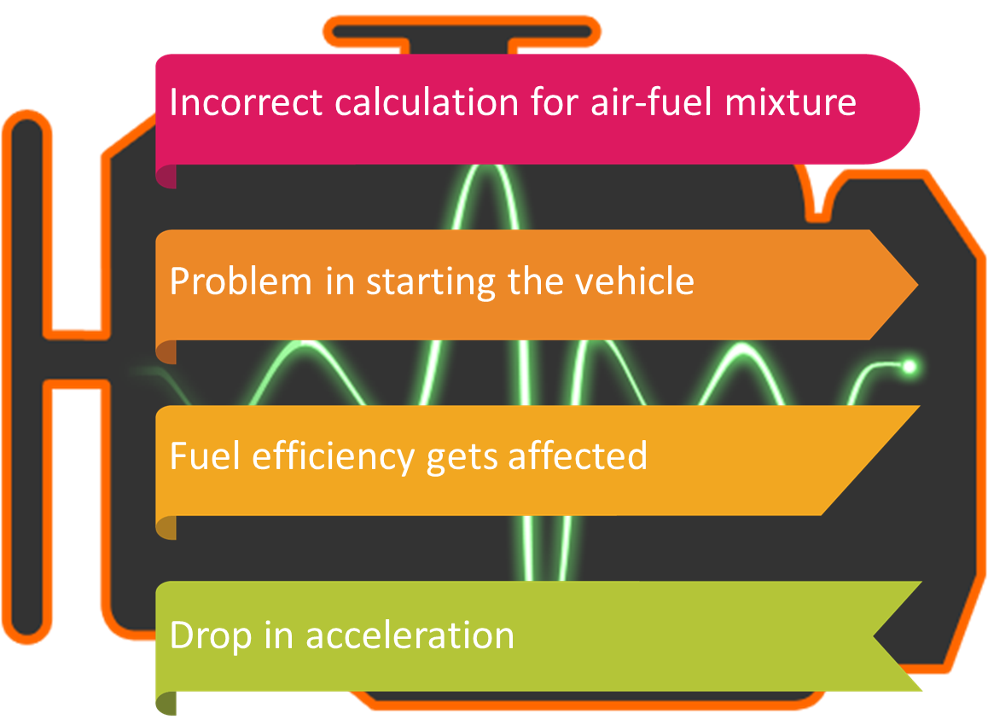
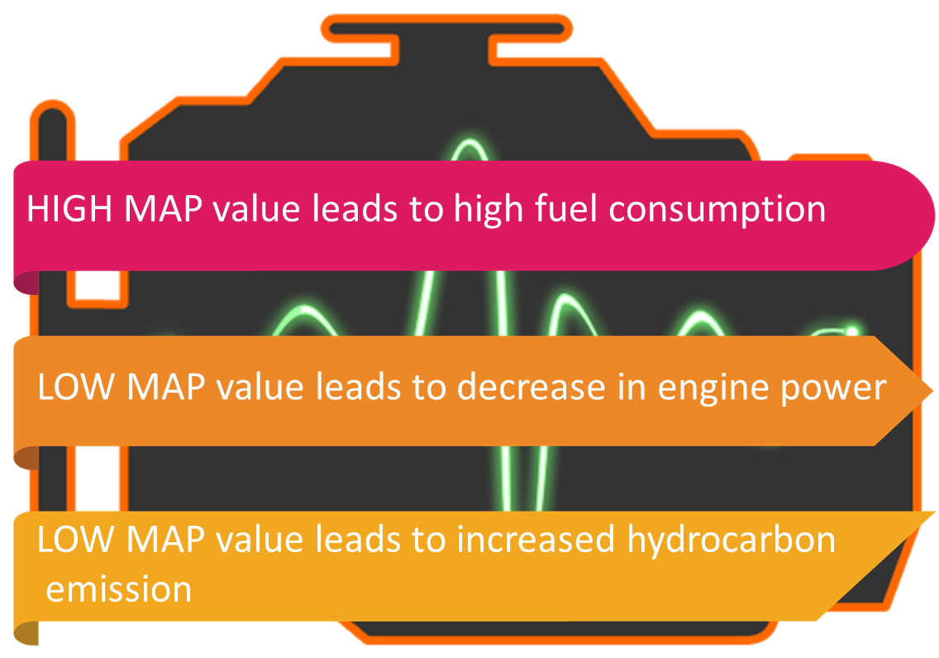
Intake Air Temperature (IAT) Sensor
Manifold Absolute Pressure(MAP) Sensor
General value: Ambient Temp +- 10⁰C
A undesirable IAT sensor value may lead to following problems:
General value:
At idle : 101.325 Kpa
At 2500 rpm: 60-67 Kpa
A undesirable MAP sensor value may lead to following problems:

Slide 14
CHALLENGES FACED IN THIS PROJECT
ESP32 memory partition management
Resource Problem for MongoDB
Handling Interlocks between different threads
Software serial Problem
HTTPS request failure problem
Password exposure in MongoDB

Slide 15
THANKS

Slide 16
Android Apps: 1.User App 2.Conductor App

Slide 17
ADD ENTRY
MongoDB (Post)
Start
Start
Store Filled Information
Password encryption
https endpoint → realm fun(payload)
QR code validation
JSON format conversion
Check = 3
Payload Text => JSON obj
Set https endpoint URL
https.post(JSON text)
Obj [ts] = time-stamp
https response code == 200
(--check) >0
Try(Insert doc) :: catch (e)
No
Yes
Success
Response code = 4xx
Yes
No
Show success msg
Show N/W failure msg
Navigate to
monitoring screen (Tag-id)
Response code = 200
End
End

Slide 18
Log in
Start
MongoDB
Check = 3
Start
Set https endpoint URL
https.post(ID)
https endpoint → realm fun(payload)
https response code == 200
(--check) >0
Query( payload.text )
No
Success
Response code = 4xx
Yes
No
Decrypt & store password from response content and enable pswd box
Show N/W failure msg
Response code = 200
Response content = doc
End
End
Password match
Navigate to monitoring Screen
Yes
Show Password mismatch msg

Slide 19
Remove
Entry
Start
MongoDB
Check = 3
Start
Set https endpoint URL
https.post(ID)
https endpoint → realm fun(payload)
https response code == 200
(--check) >0
Query(payload.text)
No
Success
Response code = 4xx
Yes
No
Store password from response content and enable pswd box
Show N/W failure msg
Delete Entry
Response code = 200
End
End
Password match
Set Endpoint URL for delete
https.post(ID)
Navigate to Home Screen
Yes
Show Password mismatch msg

Slide 20
CONTRIBUTIONS
Asset Securing System:
Hardware :
Gateway
Tag
Software :
User App
Conductor App
Database deployments:
Endpoint functions for post, get, update and delete requests
Charts for Asset Status, Lock Status
Vehicle Monitoring System:
Hardware:
Master Gateway
Database deployments:
Endpoint functions for post, get, update requests for OBD data
Charts for all the OBD parameters

Slide 21
Real Time Experiment 1
Aim : To store the location details of the vehicle during travel and retrace the route taken later
Location: IISC campus
Date & Time : 06/06/22 1:00 P.M.
Vehicle : Pulsar RS-200
Weather Condition : Temp: 21⁰ C , Humidity: 66%, Precipitation: 0mm
Path Details: The path started from DESE dept. and ended at chemical Science Dept. It was covered with trees having space between leaves to allow clear sky exposure to the signals of GPS Module
Observation : According to the led indicator, the GPS module was able to get network throughout the path

Slide 22
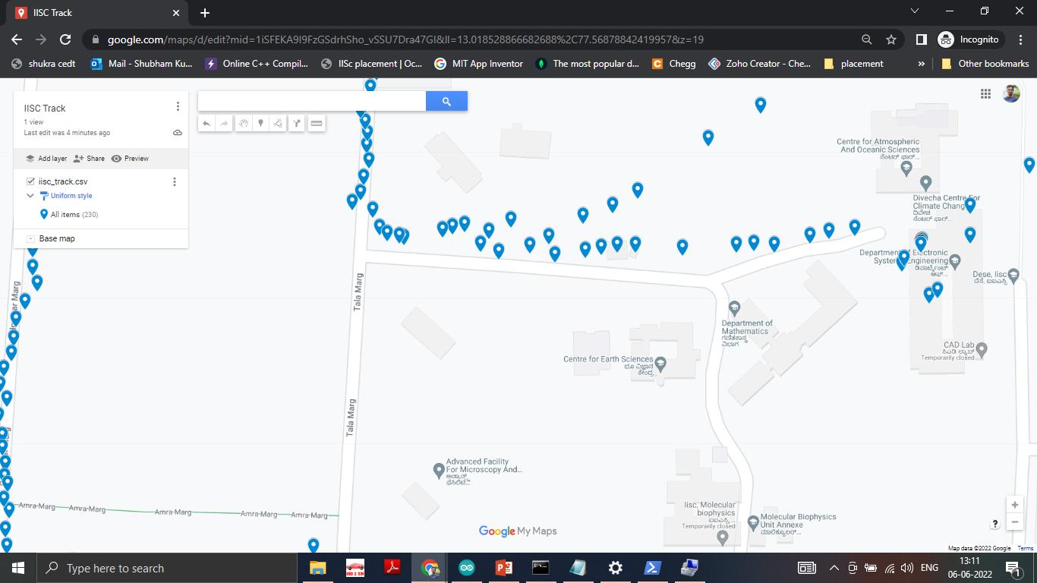
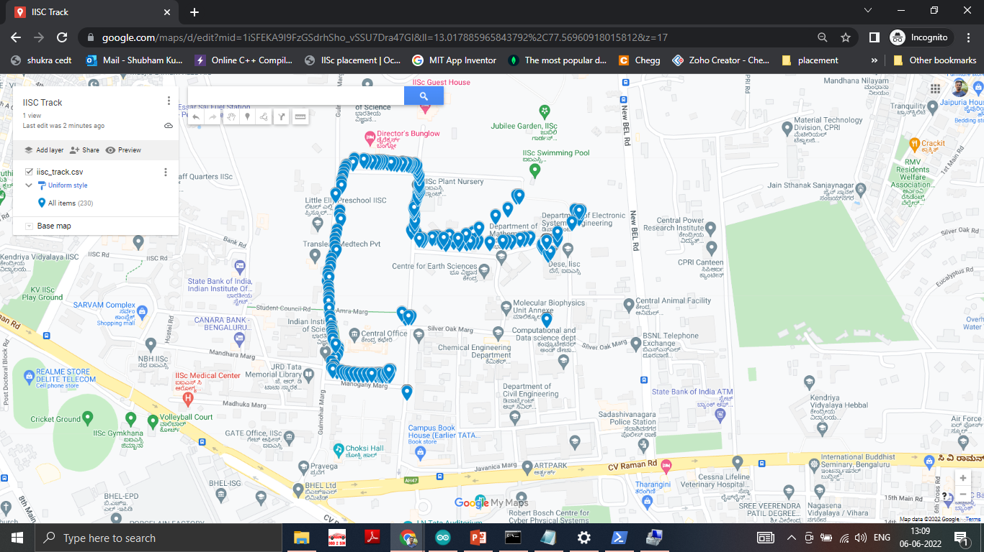
Re-traced route in G-Maps

Slide 23
Real Time Experiment 2
Aim : To get the OBD parameter value for Engine RPM of the vehicle during travel and store in MongoDB
Location: IISC campus
Date & Time : 7/06/22 2:10 P.M.
Vehicle : TATA TIAGO-XL
Path Details: The path started from DESE dept. and ended at Ramaia Gate
Observation : We have successfully received response for OBD request and stored the parameter value in database

Slide 24
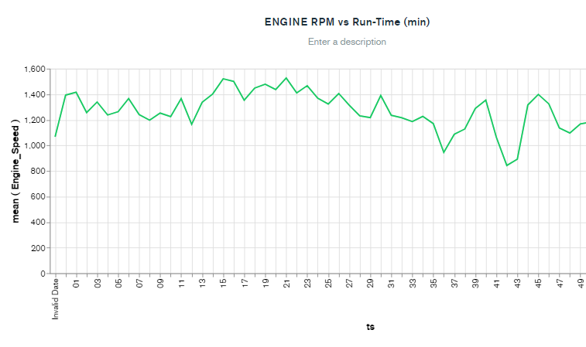

Slide 25
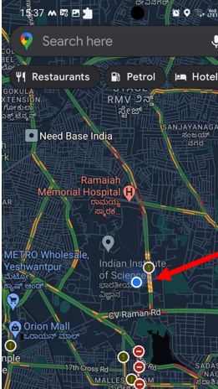
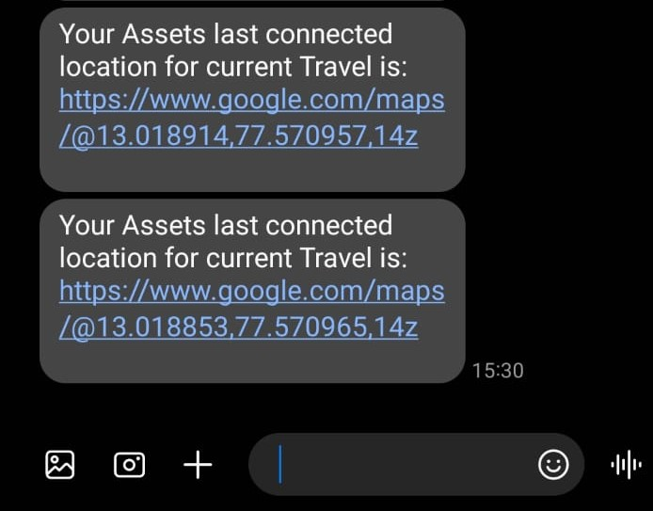
Sample Location SMS
Location output in G-MAP

Slide 26
THANKS

Slide 28
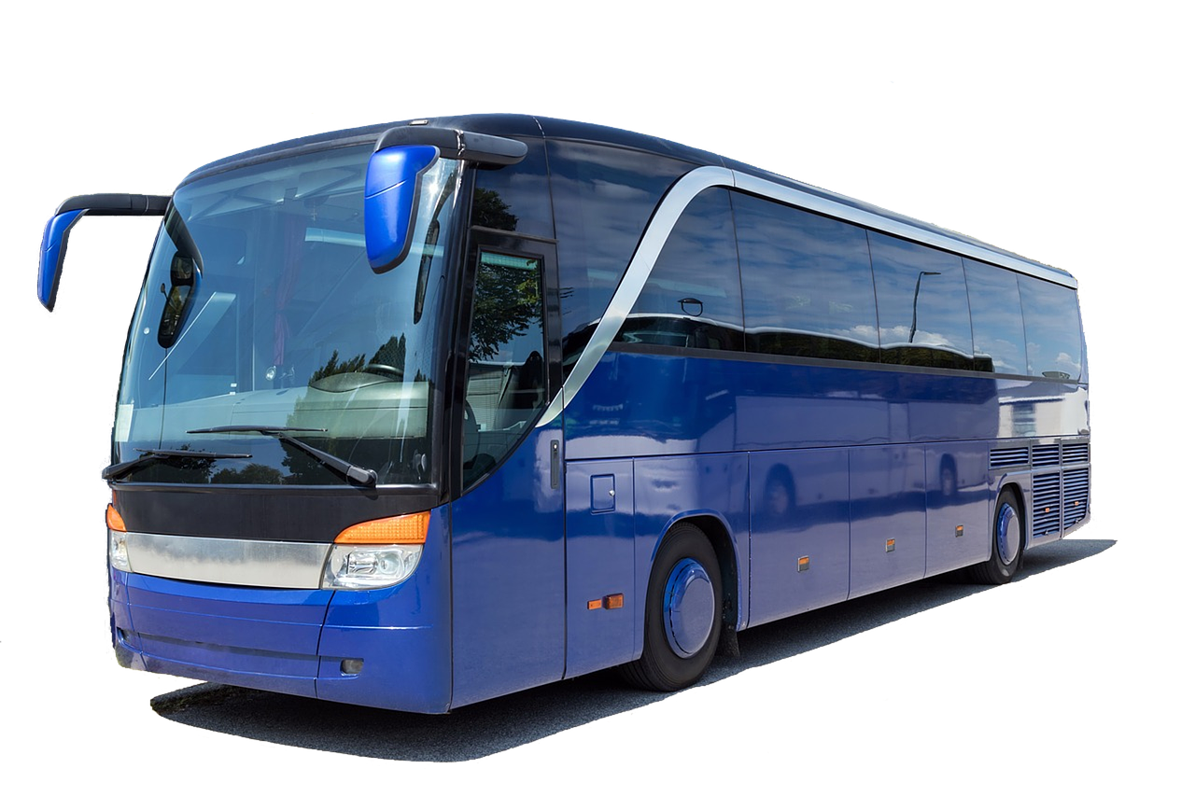


Slide 29
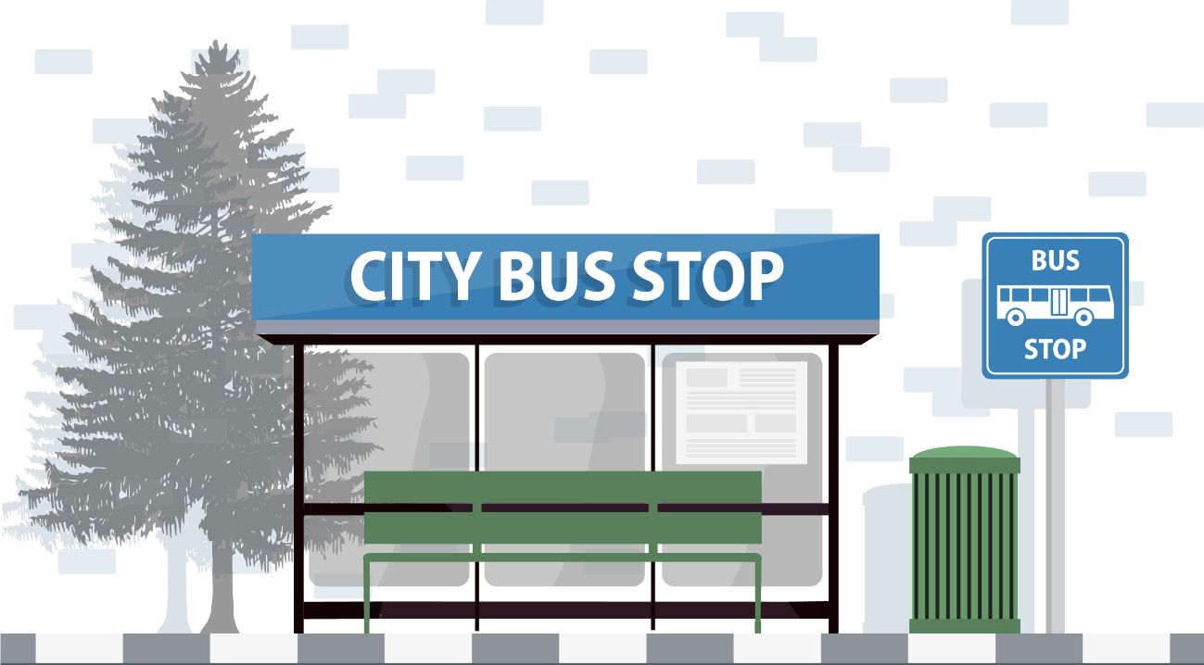


Slide 30


Slide 31
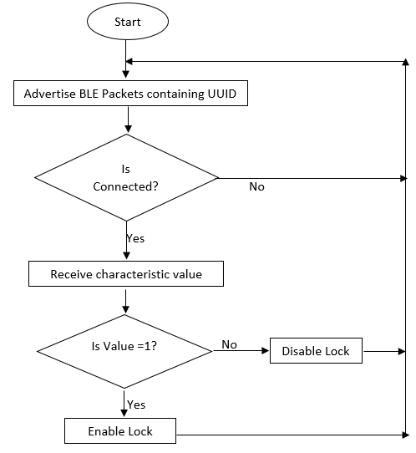

Slide 32
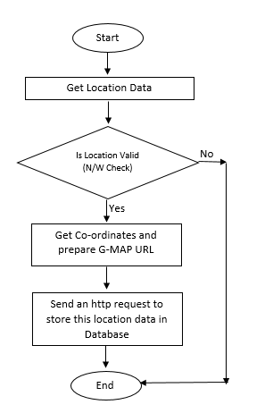

Slide 33
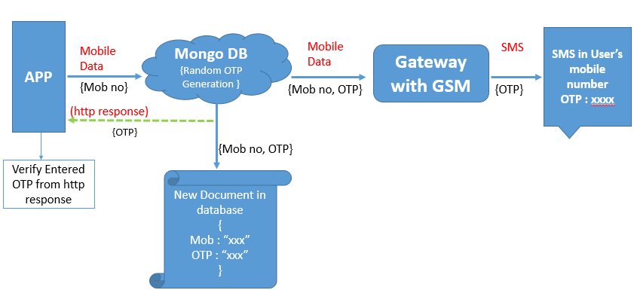

Slide 34
Start
Asset Status Update
Lock Status Update

Slide 35
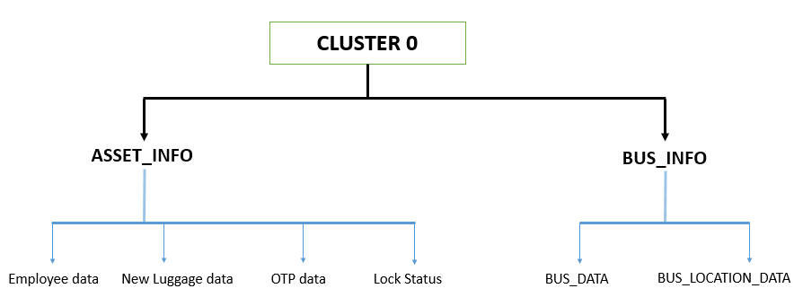
MongoDB Data Arrangement

Slide 36
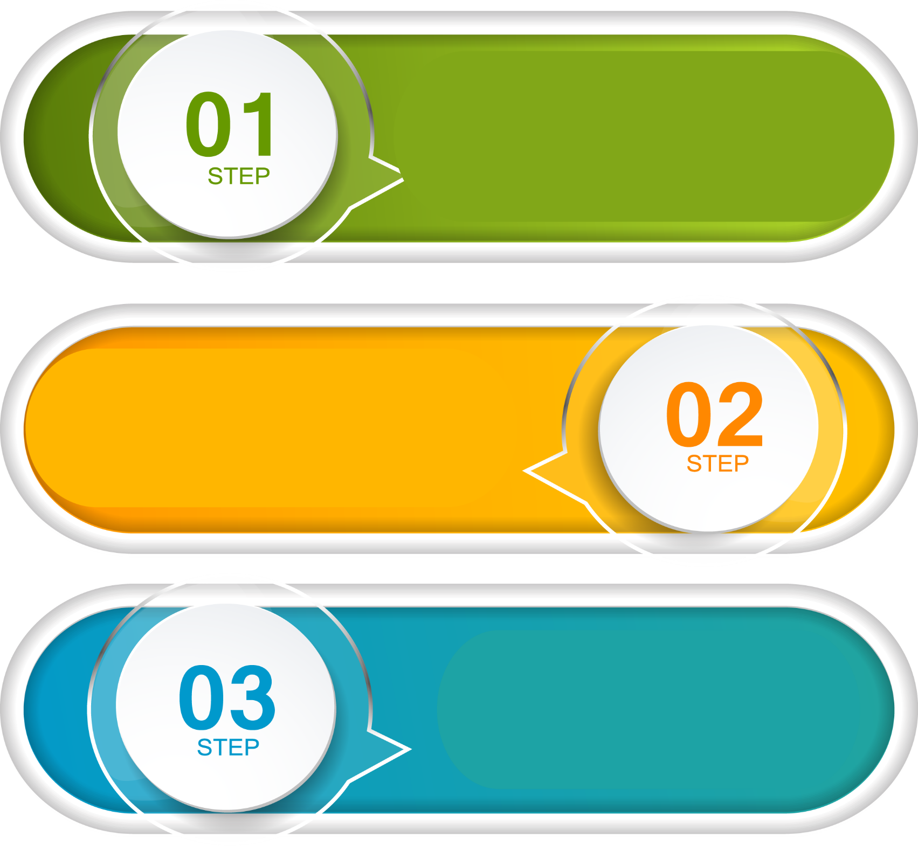

ADD ENTRY
CONNECT
DELETE ENTRY

Slide 37


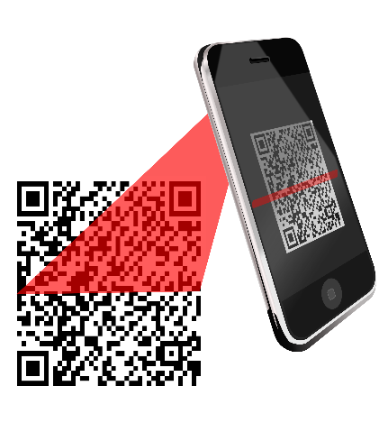




Fill Details
Scan Tag-id
ADD ENTRY
Add
Password

Slide 38

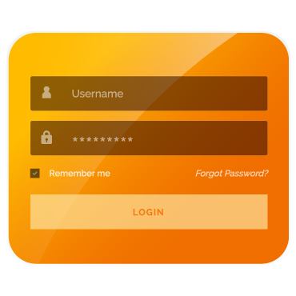

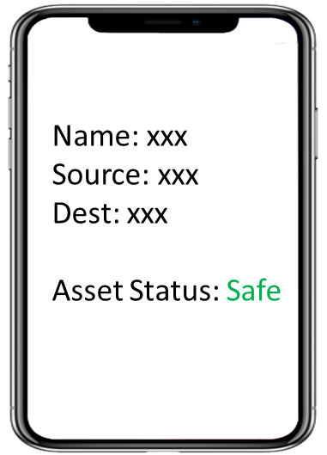
CONNECT

Slide 39

DELETE
ENTRY

Slide 40
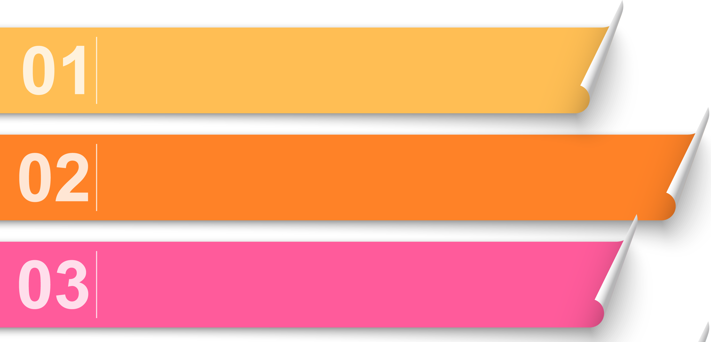


LOG IN
CREATE NEW ACCOUNT
REMOVE ENTRY

Slide 41

Fill Details
Create New Account
Scan
Authorization
Card
Add
Password

Slide 42
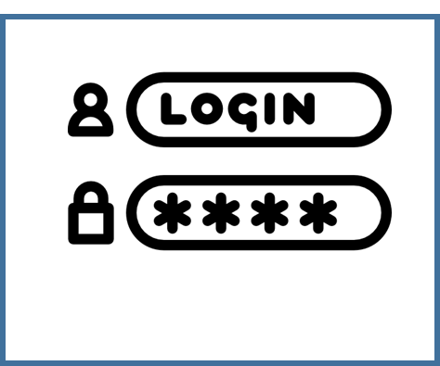



LOG IN

Slide 43


Remove Entry

Slide 44
GPS Track

Slide 45
ESP32 memory partition management :
The default partition scheme for ESP32, used by the Arduino IDE is such that only 1.2 MB out of 4 MB flash is dedicated for our application code and the rest memory gets reserved for OTA (Over the air update ) and SPIFFS. Since the libraries for Bluetooth low energy (BLE) are quiet large, it caused problem in adding the codes for connecting to the database. This problem was solved by repartitioning of the memory in the partition CSV file used by the software. The application code data size was reallocated to 3.8MB and the remaining 0.2 MB was allocated to OTA and SPIFFS.
Resource Problem for MongoDB:
Due to frequent updates in MongoDB, the resources present in internet for learning the handling of this database were outdated. Many options were removed, renamed or merged with another settings. Many times we had to run hit and trial method to observe and learn. This consumed a lot of time in the beginning.
Handling Interlocks between different threads:
By default all the processes defined in the app were parallel. Due to this, during verification the app responded wrongly in case of any delay in receiving https response. This problem was handled by making the processes sequential by the use of flags.

Slide 46
Software serial Problem:
Using software serial UART communication for interfacing GPS and GSM modules created a problem. This library is poor in handling interrupts and causes corruption of data. Due to this both the GPS and GSM interface were separately successful but it caused problem when we merged them. Since the ESP32 board has extra unused UART pins, this problem was solved by using Hardware serial UART communication.
HTTPS request failure problem:
The software and hardware used in this project are interconnected to each other by the cloud MongoDB. For every communication action, https requests are made to the cloud. Due to network problem, if these https request gets failed, the whole process gets interrupted. In this case the users had to make multiple attempts for same task from their app. This problem was later on solved by checking the response codes and resending request in case of failure.
Password exposure in MongoDB:
MongoDB stores all the information of users and conductors. This data also contains the login passwords. This will get exposed to the official workers of the bus company. Therefore an encryption scheme is used to for storing the passwords safely.

Slide 47
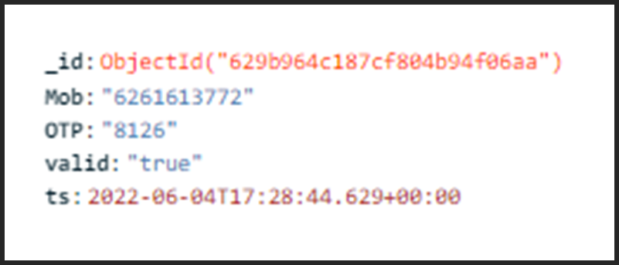
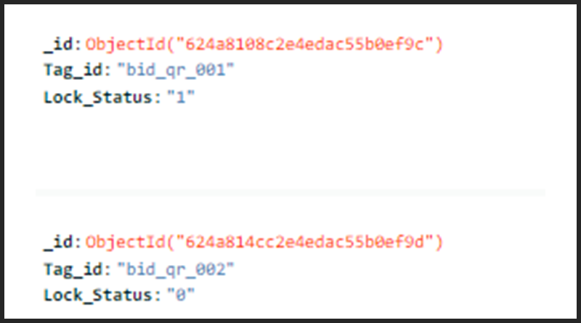
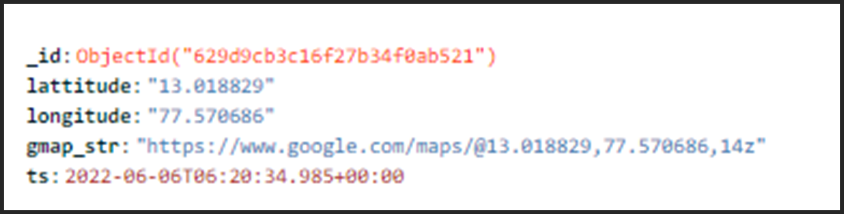
Sample document for OTP data
Sample documents for Lock data
Sample document for Location data

Slide 48
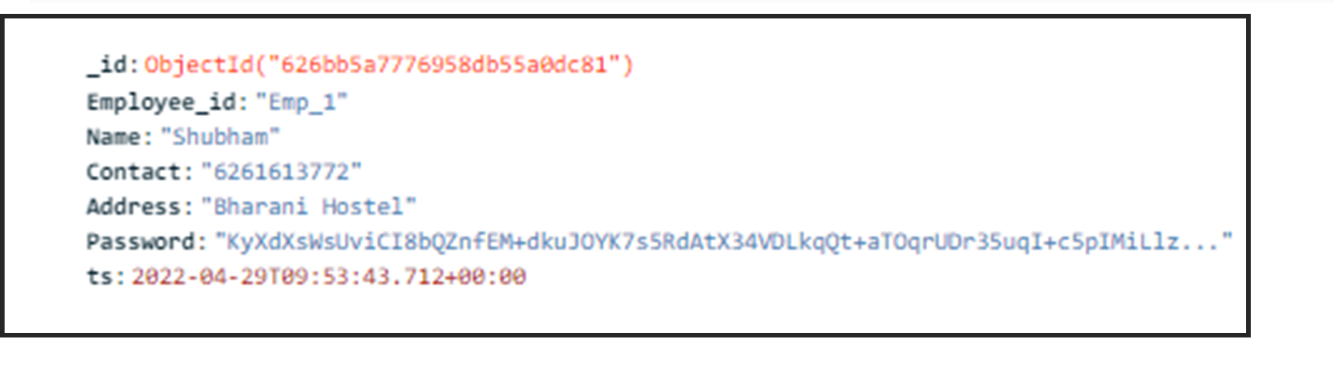
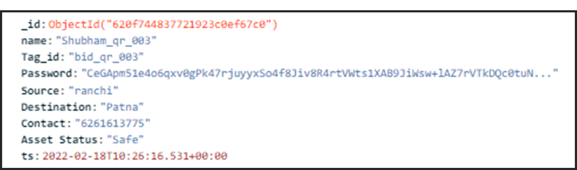
Sample Document for Employee data
Sample Document for User data

Slide 49
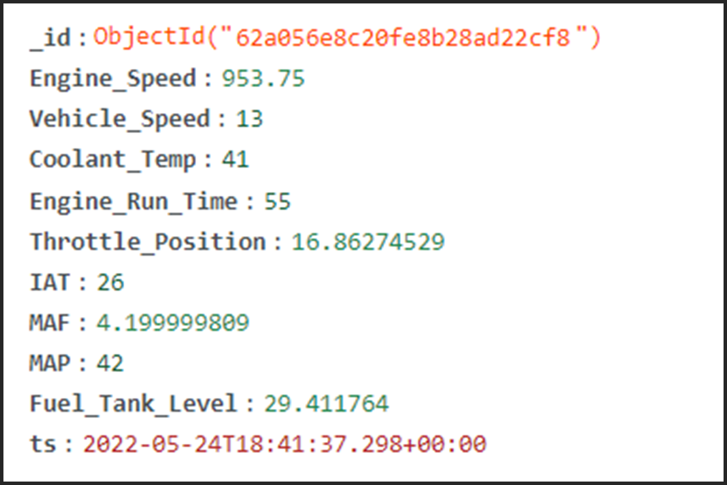
Sample Document for OBD data

Slide 50
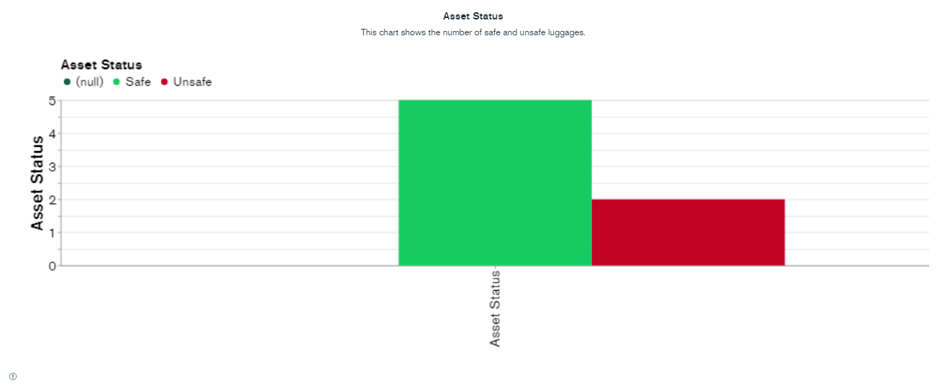
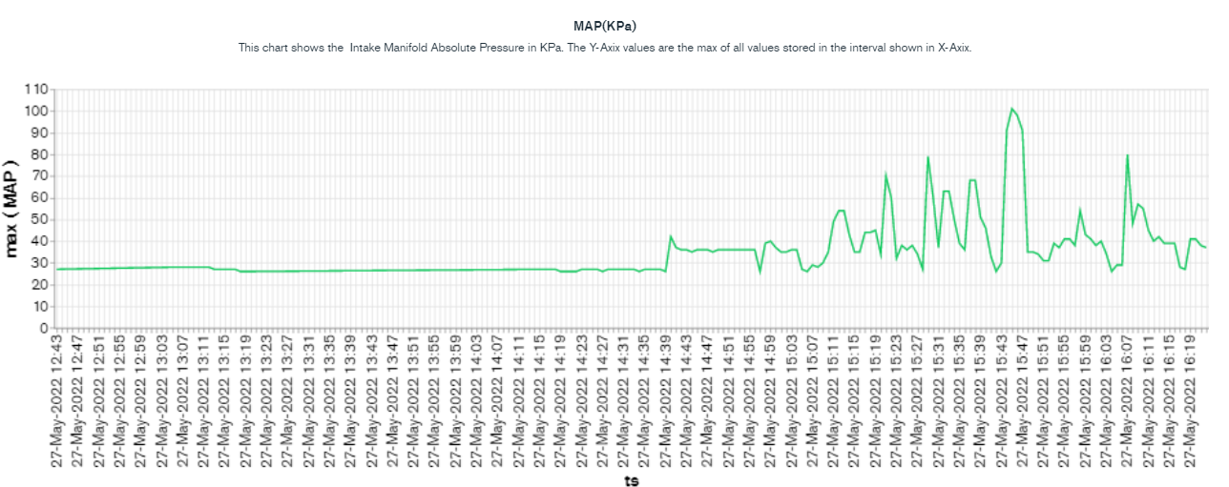

Slide 51
BLE explaination

Slide 52
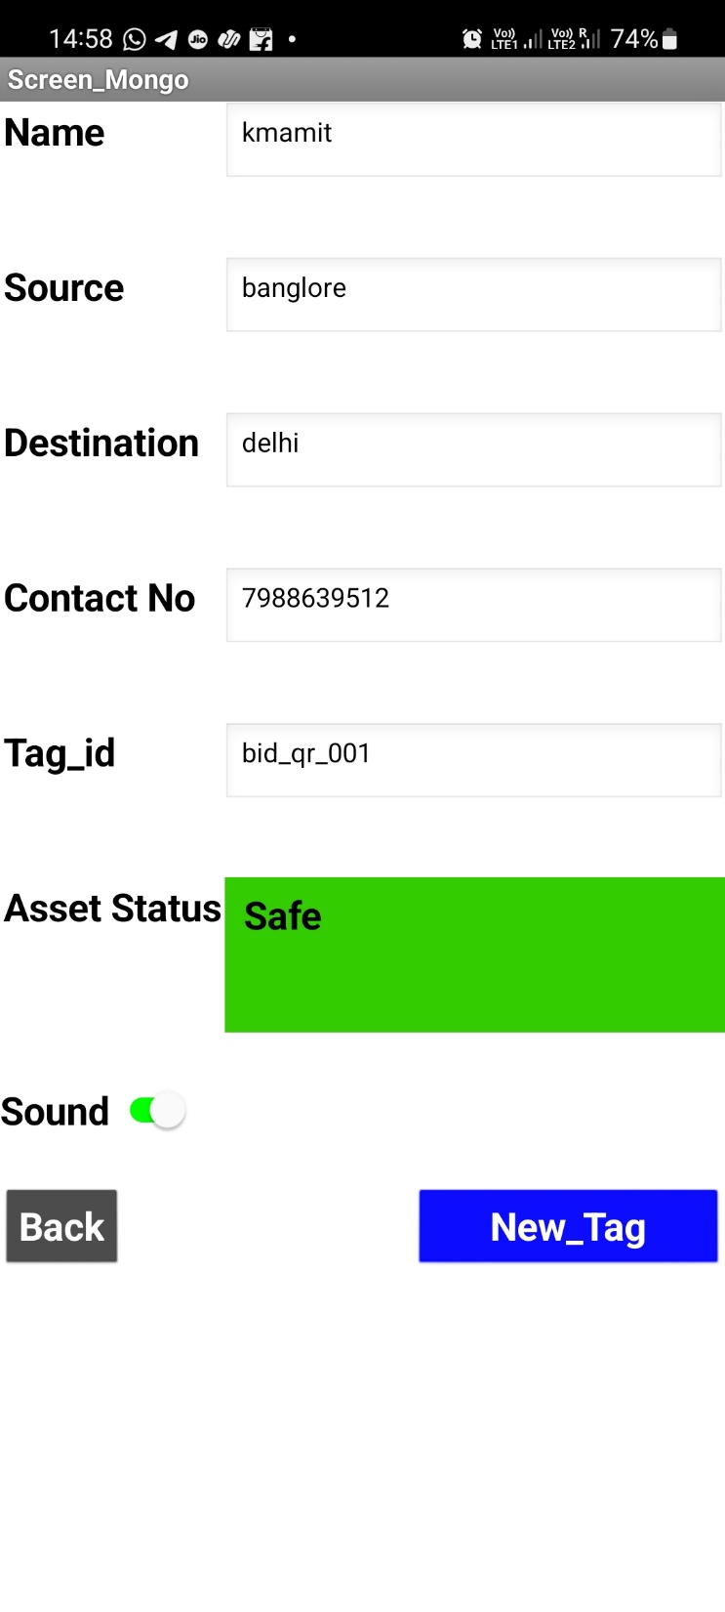
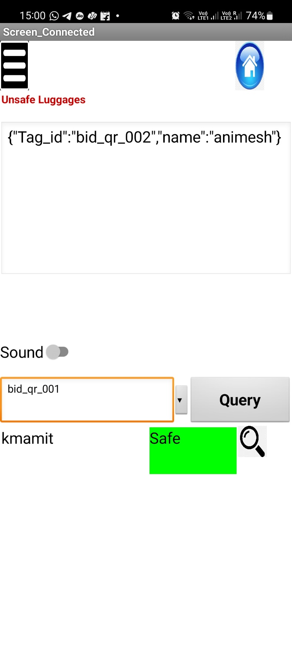
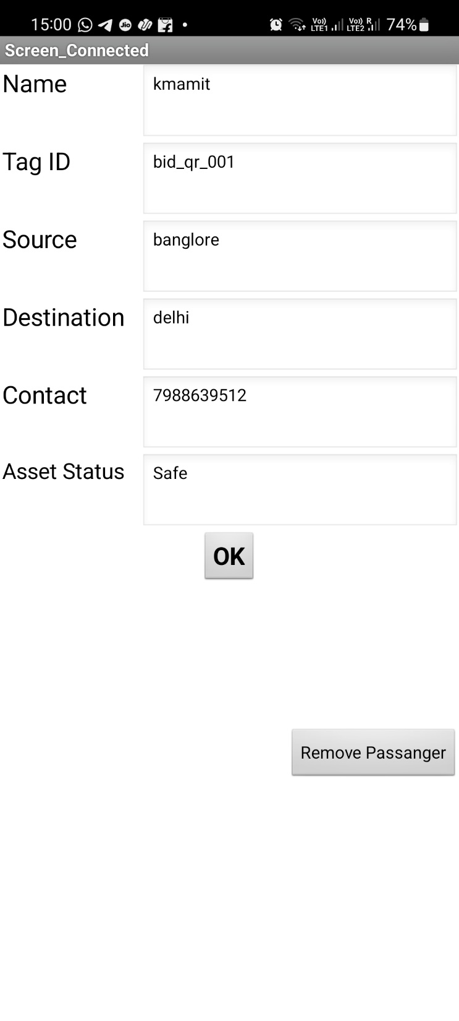
User App
Conductor App
Queried Passenger’s Detail
(Conductor App)

